Slide 1
Elements of graphic notation of service diagram

Slide 2

Service diagrams are a type of flowchart used to illustrate the various components of a service and how they interact.

Slide 3
Representation
The flowchart is the most widely used graphical representation for procedural design. The flowchart is quite simple pictorial.
Flowcharts are one of the most basic types of diagrams you can make. Their simplicity makes them an effective tool for visualizing the logic of an algorithm or program before you start coding.

Slide 4
Flowchart Basic Procedure
Define the process to be diagrammed. Write its title at the top of the work surface.
Discuss and decide on the boundaries of your process: Where or when does the process start? Where or when does it end? Discuss and decide on the level of detail to be included in the diagram.
Brainstorm the activities that take place. Write each on a card or sticky note.
Arrange the activities in proper sequence.
When all activities are included and everyone agrees that the sequence is correct, draw arrows to show the flow of the process.
Review the flowchart with others involved in the process (workers, supervisors, suppliers, customers) to see if they agree that the process is drawn accurately.

Slide 5
Rounded Rectangle
Used to represent the starting point or terminal point of a flowchart

Slide 6
Rectangle
Represents processes(e.g. mathematical operations)

Slide 7
Diamond
Decision based on a question. The question is written in the diamond. More than one arrow goes out of the diamond, each one showing the direction the process takes for a given answer to the question. (Often the answers are "yes" and "no.")

Slide 8
Lines
Connects components in a flowchart

Slide 9
Input/output
Represents information or data, that is transmitted or received

Slide 10
database
Represents databases

Slide 11

person
Represents actors or users or a software system

Slide 12
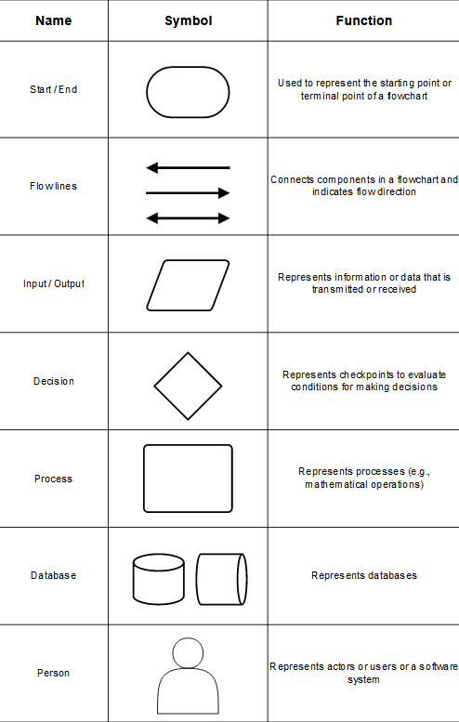

Slide 13
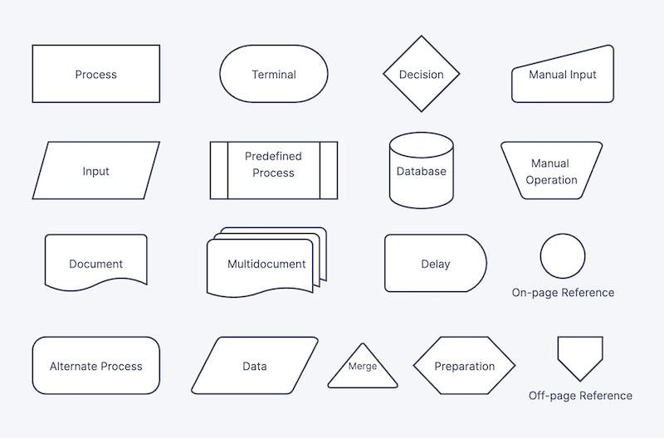
Additional notation

Slide 14
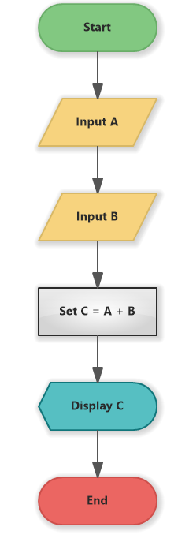

Slide 15
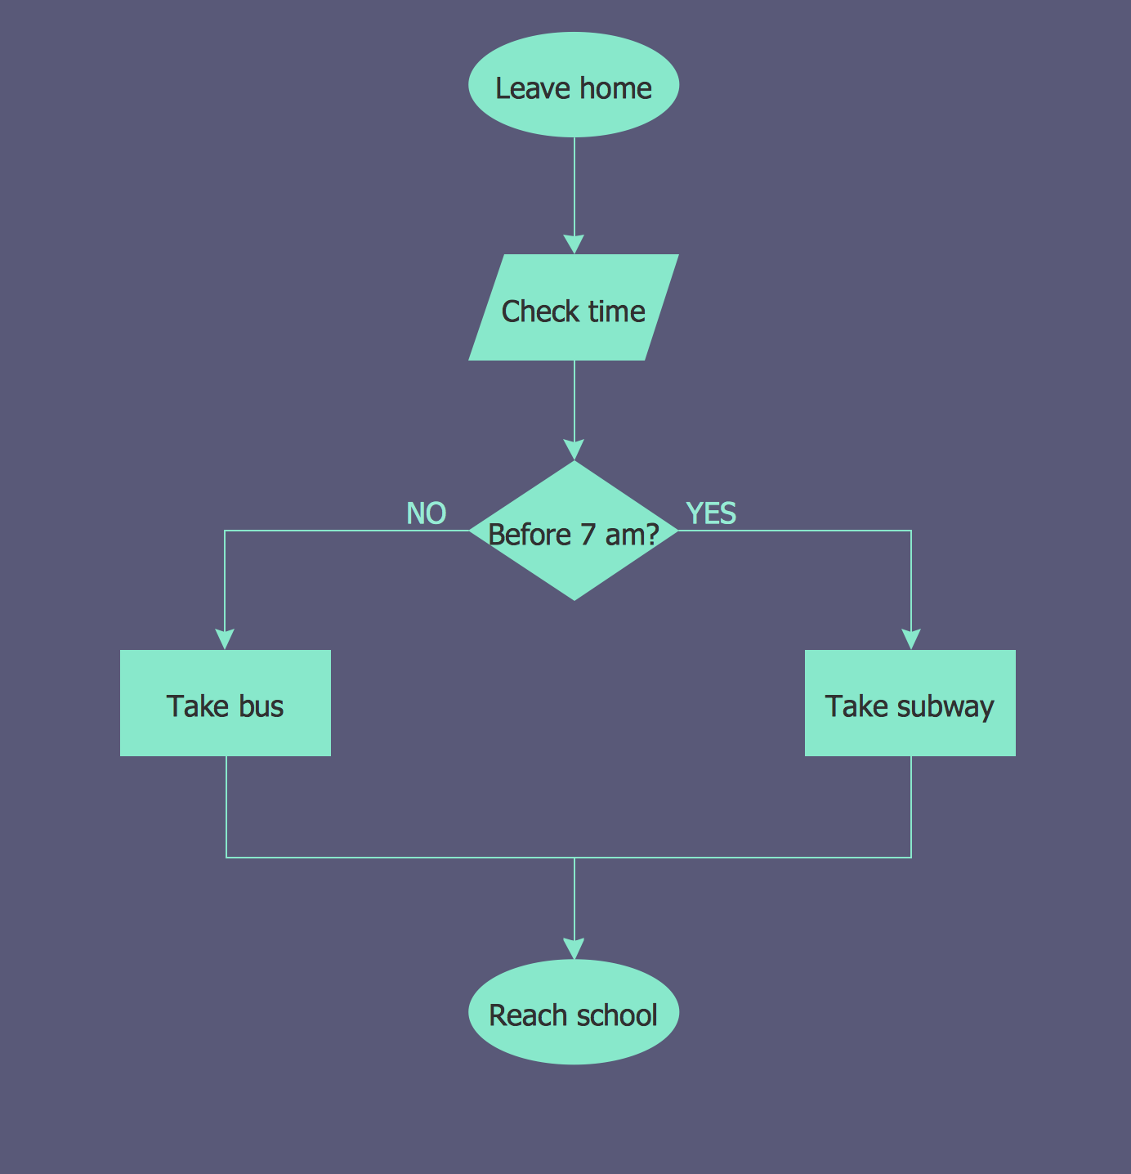

Slide 16
exercises
Create a flowchart of a SIMPLIFIED service(booking a flight, getting a library card, or using a vending machine)
Choose a simple algorithm and create a flowchart for it (bonus: code implementation)

Slide 17
END

Slide 18
Software architecture
Software architecture describes the fundamental concepts and properties of a system within the context of its environment, relationships, principles of design, and more. Software architecture encompasses the organization of a software system, structural elements, behavioral elements, and the composition of those elements into larger subsystems. Software systems can often contain multiple architectures.

